Slide 1
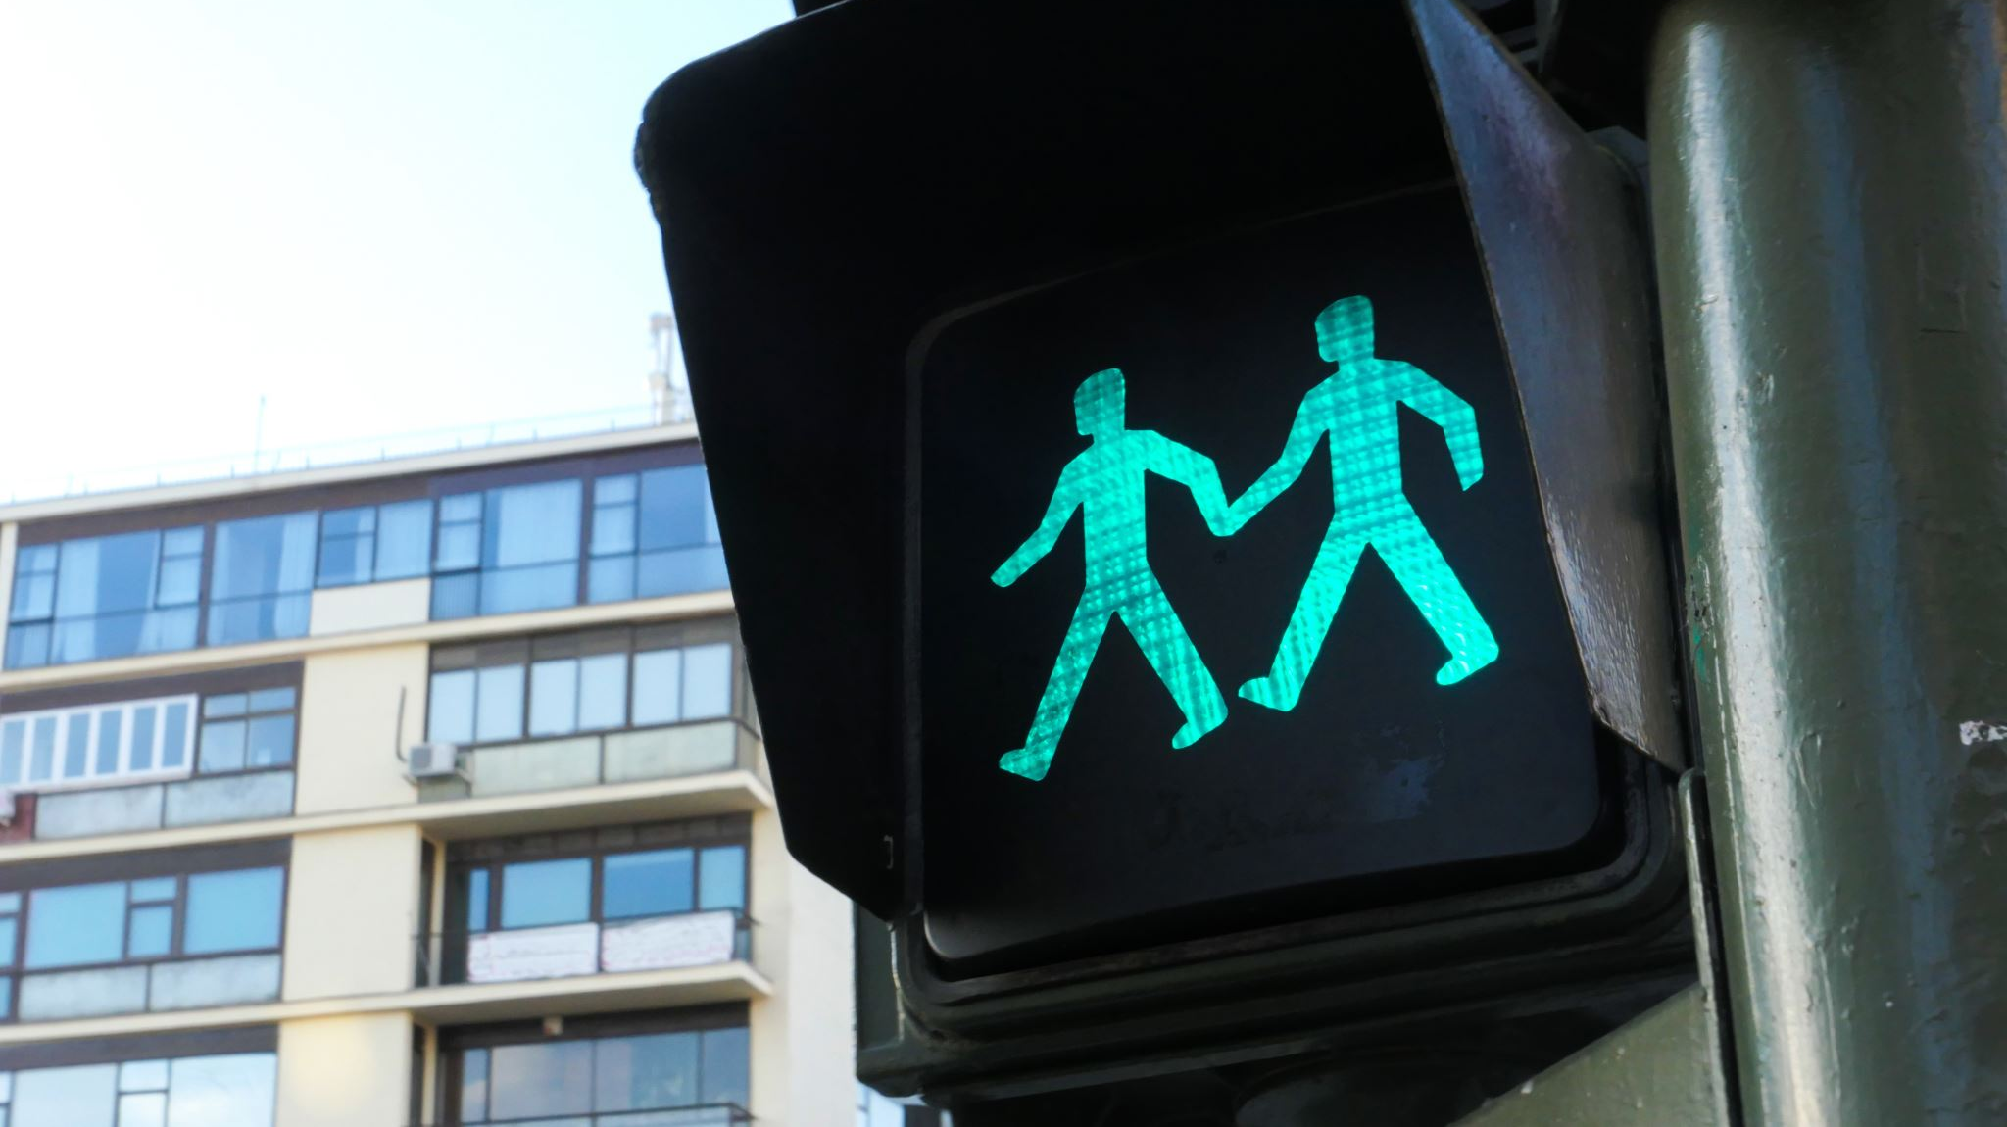
Traffic Monitoring & Detection
By,
Varshitha Challa (2156555)
Janaki Obillaneni(2149246)

Slide 2
Introduction
In this project, our aim is to meet the demands of modern urban infrastructure and to set a precedent for AI-driven urban management systems.
The Traffic Monitoring & Detection project leverages a diverse dataset from various countries, primarily Turkey, to enhance object detection algorithms for identifying various elements like vehicles and pedestrians in traffic.
The system's adaptability to different environmental conditions ensures reliable performance across various weather scenarios and times of day. Beyond traffic monitoring, the project's applications extend to proactive traffic management, accident prevention, and smart city development.
It utilizes advanced computer vision and deep learning methods to detect Objects and to improve road safety, reduce congestion, and facilitate smoother traffic flow.
The purpose of our project is to detect objects with high accuracy and real-time performance.
A real-time image will be the system's input, and its output will be a bounding box that corresponds to each object in the image and indicates the type of object in each box.

Slide 3
Problem Statement
Complexity in Object Identification: Computers and other robots have a difficult time recognizing and locating numerous distinct things inside a single image, a skill that humans do more quickly.
Insufficient Traditional Methods: The complexity of contemporary urban traffic flow is being too much for the current traditional traffic management techniques, which is producing issues like congestion, accidents, and inadequate traffic circulation.
Need for Advanced Technologies: Better real-time and dynamic object identification technologies that can precisely recognize and locate items within a variety of contexts are required, despite the abundance of software and apps now available.

Slide 4
Objective and motivation
Our main objective is that the application can identify objects and be used to identify the vehicles that have gone through a given image of a road. It can also count the number of vehicles , such as a car or bicycle, and can also detect human with the bounding boxes
The main motive of the project is for object detection, YOLO (You Only Look Once) is preferred because of its speed, which allows for real-time processing, which is essential for applications like driverless cars. Increasing speed single neural network architecture and streamlines the detecting process without sacrificing accuracy. Because of its comprehensive approach to image watching, YOLO is able to leverage contextual information, which makes it incredibly powerful and adaptable in a variety of situations.

Slide 5
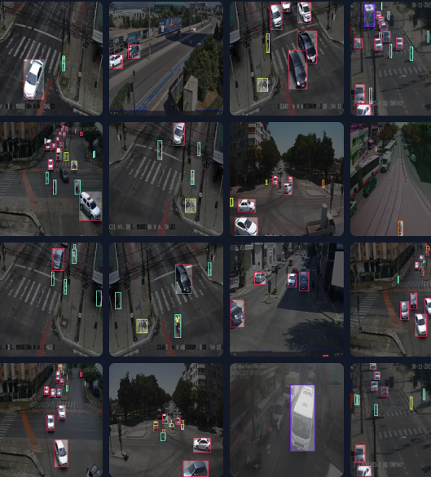
Dataset
We have around 8693 images in the dataset. They have been divided into train, test and validation datasets
Testing images:322
Training images: 7566
Validation images:805
Images are categorized based on a different weather and traffic situations of trucks, car, motorbike and bicycle, pedestrians

Slide 6
Data Augmentation and Preprocessing
Preprocessing:
Preprocessing the data before feeding it to a model is an important step as we can clean the irrelevant or unnecessary data and improve the accuracy and the performance of the model. Auto-Orient is Applied and Resized the images to 640x640
Augmentations:
It is a technique used in Machine learning model which increases the size of the data for training models without gathering new data by performing different operations, such as flipping horizontally, reducing the noise, setting the range for Saturation (-61% and +61%) and Brightness(-25% and +25%)

Slide 7
Methodology
To evaluate the performance of the models and examine the observations of them at various stages for detecting objects we used YOLO (you only look once). In working with YOLO, we implemented two models, which are YOLOv8 and YOLO-NAS
For object detection, YOLO is a cutting-edge, real-time object detecting technology.
It is a set of end-to-end deep learning models intended for quick object detection comprise the "family of models."
YOLO is preferred because of its speed, which allows for real-time processing, which is essential for applications like driverless cars.
How YOLO works???
It uses a single pass neural network approach to capture contextual visual information.
Because of its simplicity and real-time processing speed, YOLO is the favored method for object detection tasks.
Because of its effectiveness and constantly improving accuracy, it can be applied to a wide range of real-world scenarios and is continuously improved by a vibrant community.

Slide 8
YOLO ARchitecture
YOLO architecture has four primary parts. They are as follows:
i. Backbone: Information is extracted from the input image using convolutional neural networks (CNNs), which serve as the system's backbone. The CNN is composed of a series of activation functions, pooling layers, and convolutional layers.
ii. Neck: The neck connects the predicted head and the backbone and is composed of multiple layers. By leveraging the neck layers to fuse features from different backbone levels, object detection accuracy can be improved.
iii. Prediction Head: Each cell in the input image has its bounding boxes and class probabilities estimated by a group of layers in the prediction head. The prediction head is typically composed of fully connected layers and activation functions.
iv. Output layers: These are made up of several layers that convert the prediction head's output into a form that can be understood. The output layers are typically where bounding box coordinates and class probabilities are determined.

Slide 9
YOLOv8
The YOLOv8 real-time object detector is the most recent version in the YOLO series, providing state-of-the-art speed and accuracy.
YOLOv8, which builds on the innovations of earlier YOLO versions and adds additional features and optimizations that make it the best option for a variety of object identification tasks across a broad range of applications.
Key Features:
Advanced Backbone and Neck Architectures: YOLOv8 uses cutting-edge backbone and neck architectures to enhance performance for object identification and feature extraction.
Anchor-free Split Ultralytics Head: In contrast to anchor-based methods, YOLOv8 uses an anchor-free split Ultralytics head, which improves accuracy and streamlines the detection process.
Optimized Accuracy-Speed Tradeoff: YOLOv8 is appropriate for real-time object identification jobs in a variety of application fields since it places a strong emphasis on preserving an ideal balance between accuracy and speed.
Variety of Pre-trained Models: YOLOv8 makes it simpler to select the ideal model for your particular use case by providing a selection of pre-trained models that are tailored to meet a variety of jobs and performance needs.

Slide 10
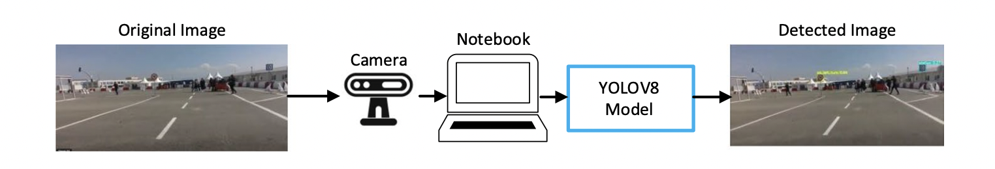
workflow of an object identification
This procedure demonstrates how well YOLOv8 detects objects in real-time applications.
YOLOv8 model object detection processis done in 3 elements.
At first image is taken using a camera, then it is processed on a computer using a YOLOv8 model, and the result is an output image that shows the objects that have been detected within bounding boxes.

Slide 11
YOLO-Nas
YOLO-NAS uses selective quantization and quantization-aware blocks
Compared to other models, the model exhibits a minor precision decrease when converted to its INT8 quantized version.
The result of these developments is an improved architecture that performs exceptionally well and has never-before-seen object identification capabilities.
Key features:
Quantization-Friendly Basic Block: YOLO-NAS addresses a major shortcoming of earlier YOLO models by introducing a new basic block that is amenable to quantization.
Complex Training and Quantization: To improve performance, YOLO-NAS makes use of complex training schemes and post-training quantization.
Pre-training and AutoNAC Optimization: YOLO-NAS is pre-trained on well-known datasets like Roboflow 100, Objects365, and COCO. It also makes use of AutoNAC optimization. It is very well suited for downstream object detection tasks in production situations because of this pre-training.

Slide 12
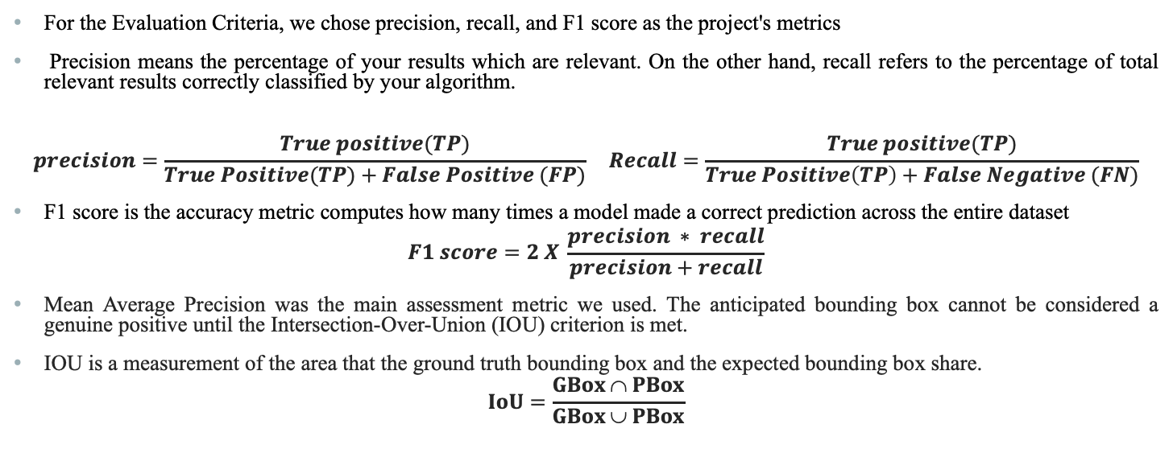
REsults
For the Evaluation Criteria, we chose precision, recall, and F1 score as the project's metrics
Precision means the percentage of your results which are relevant. On the other hand, recall refers to the percentage of total relevant results correctly classified by your algorithm.
$$precision=\frac{True positive(TP)}{True Positive(TP)+False Positive (FP)} Recall=\frac{True positive(TP)}{True Positive\left(TP\right)+False Negative (FN)}$$
F1 score is the accuracy metric computes how many times a model made a correct prediction across the entire dataset
$$F1 score=2 X \frac{precision ∗ recall}{precision+recall}$$
Mean Average Precision was the main assessment metric we used. The anticipated bounding box cannot be considered a genuine positive until the Intersection-Over-Union (IOU) criterion is met.
IOU is a measurement of the area that the ground truth bounding box and the expected bounding box share.
$$IoU=\frac{GBox ∩ PBox}{GBox ∪ PBox}$$

Slide 13
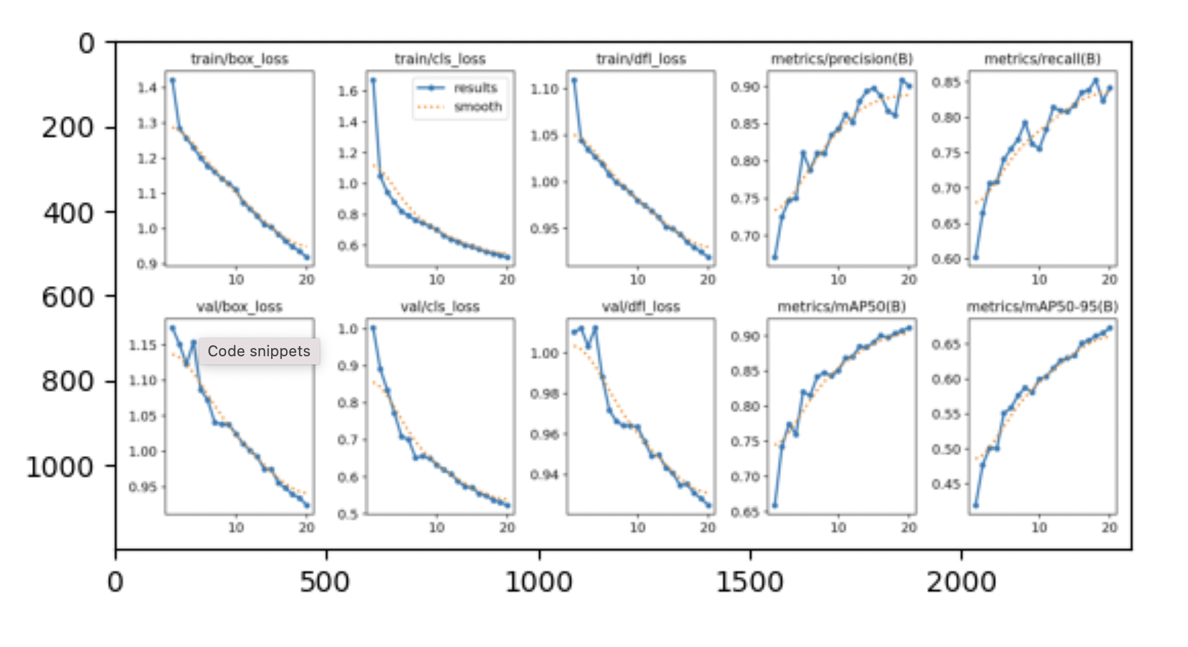
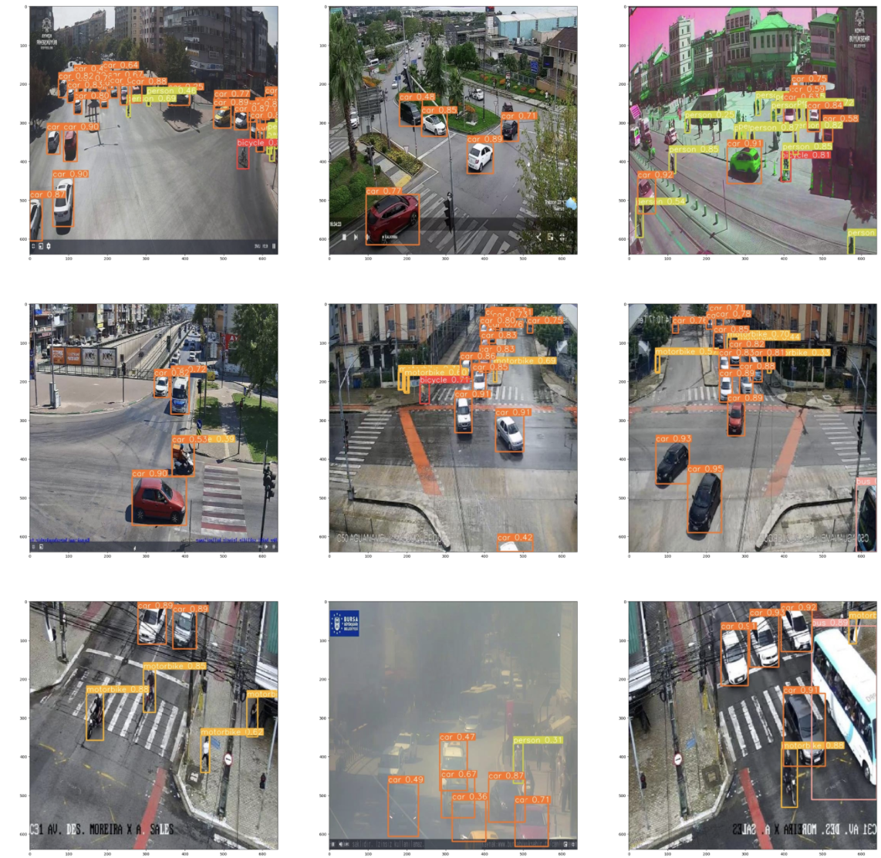
YOLOv8

Slide 14
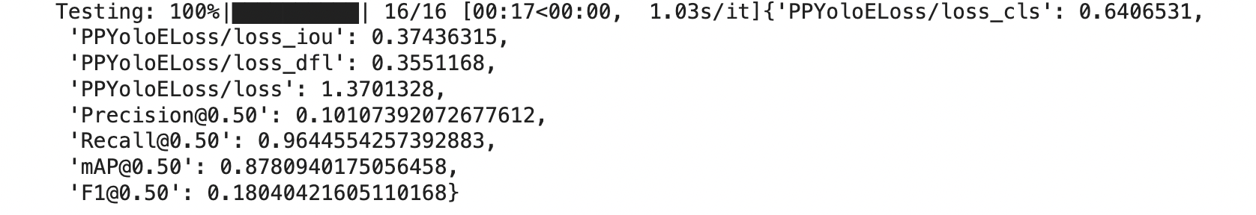
YOLO-NAS
The testing output displays the performance of an object detection model of YOLO-NAS with a classification at 0.50 IoU where the recall is 0.9644554257392883, precision is 0.10107392072677612, mean Average Precision (mAP) is comparatively high at 0.8789094175056458.Finally,the F1 score is 0.1804421065110168.
Overall the accuracy in object detection at 0.50 is good.

Slide 15
Conclusion and future work
we have mainly evaluated two versions of YOLO-based object detection algorithms to identify traffic photos from different countries.
YOLO-NAS outperformed YOLOv8 in terms of both overall and class-wise ratings, making it the top performer when comparing the two under different working conditions.
Future developments could see the emergence of even more YOLO-based model versions that outperform the ones we examined and We plan to progressively add more models—including ones with other architectural styles—as well as more samples, classifications, and analytical metrics for a more complete evaluation to the collection.

Slide 16

Thank you

